Slide 1
Dynamic Analysis: Testing
John Businge
john.businge@unlv.edu

Slide 2
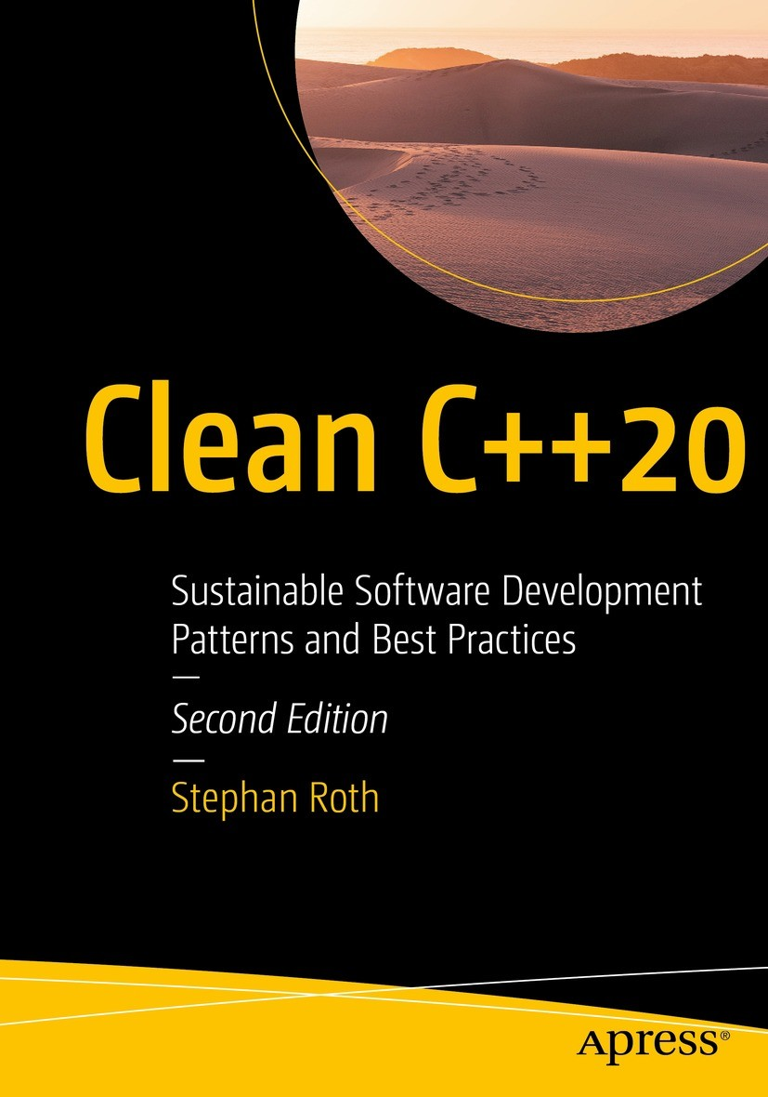
Free PDF version on Springer
https://link.springer.com/book/10.1007/978-1-4842-5949-8
Chapter 2 and Chapter 8

Slide 3
Announcements
3 students did not submit their assignment. Write to me to consider your late submission
I am not worried worried anymore about the communication
Precondition report is due tonight
Lab 2 is due Tuesday next week. Start early

Slide 4
Testing
“If it is worth building, it is worth testing.
If it is not worth testing, why are you wasting your time working on it?”
Scott Ambler, agiledata.org

Slide 5

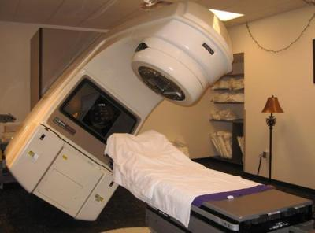





The Need for Testing
KILLED BY A MACHINE: THE THERAC-251986: MEDICAL ACCELERATOR DISASTER
One developer
Control Software
Insufficient testing
https://hackaday.com/2015/10/26/killed-by-a-machine-the-therac-25/
Notes:
This case is probably the most consequential failure in the history of software development. The medical accelerator disaster. Due to
bugs in the control software,
an insufficient quality assurance process, and
other deficiencies,
three patients lost their lives caused due to radiation overdoses.
An analysis of this case determined that, among other things, the software was written by only one person who was also responsible for the tests.

Slide 6
Dynamic Testing
Dynamic testing is a type of software testing that involves executing the code or program to check for runtime behaviours, interactions, and outputs.

Slide 7
Key Purposes of Dynamic Testing
Validation of Functional Requirements: It ensures that the software functions according to user requirements.
Identification of Defects: Dynamic testing helps in identifying issues like crashes, incorrect behaviour, and deviations from expected outcomes.
Performance Evaluation: It can also test how the software performs under certain conditions, such as high load or stress.

Slide 8
Examples of Dynamic Testing:
Unit Testing: Testing individual components or modules of the software.
Integration Testing: Ensuring that different components work together as expected.
System Testing: Testing the complete system for proper functionality.
Acceptance Testing: Verifying that the system meets user requirements before deployment.

Slide 9
Unit Testing
We focus on Unit Testing.
Unit testing focuses on the smallest testable parts of an application called units (e.g., a class method or function)
It does not mean that Unit Testing is more important, but those are the tests we can more easily automatize and benefit from tool support.
Notes:
In this lab, we are going to focus on unit testing
In unit testing, the focus is on the smallest testable parts of an application, called units (an example is a method)

Slide 10
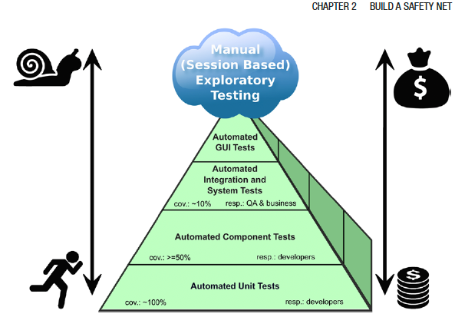

The Test Pyramid
Hard
Test Automation complexity
Experience shows that the cost of test implementation / maintainance
Easy
Aim to have more unit tests (100%). Why?
Notes:
The different testing techniques like Unit tests, Integration tests, system tests, and acceptance tests use dynamic testing.
The pyramid shape, of course, is no coincidence. The message behind it is that you should have many more low-level unit tests (approximately 100% code coverage) than any other kind of tests. But why is that?
Experience has shown that the total costs regarding implementation and maintenance of tests increase toward the top of the pyramid.
Large system tests and manual user acceptance tests are usually complex, often require extensive organization, and cannot be automated easily. For instance, an automated UI test is hard to write, often fragile, and relatively slow.

Slide 11
Why are unit tests useful?
Focus on Small, Isolated Components – function or method
Automation - Unit tests are often automated and integrated into the development process – can be part of CI pipeline – use of test frameworks
Early Detection of Bugs: Since unit tests focus on small, specific parts of the code
Test Coverage: Often measured by coverage – high coverage is desirable
TDD: central to TDD, where developers write tests before writing the actual code.

Slide 12
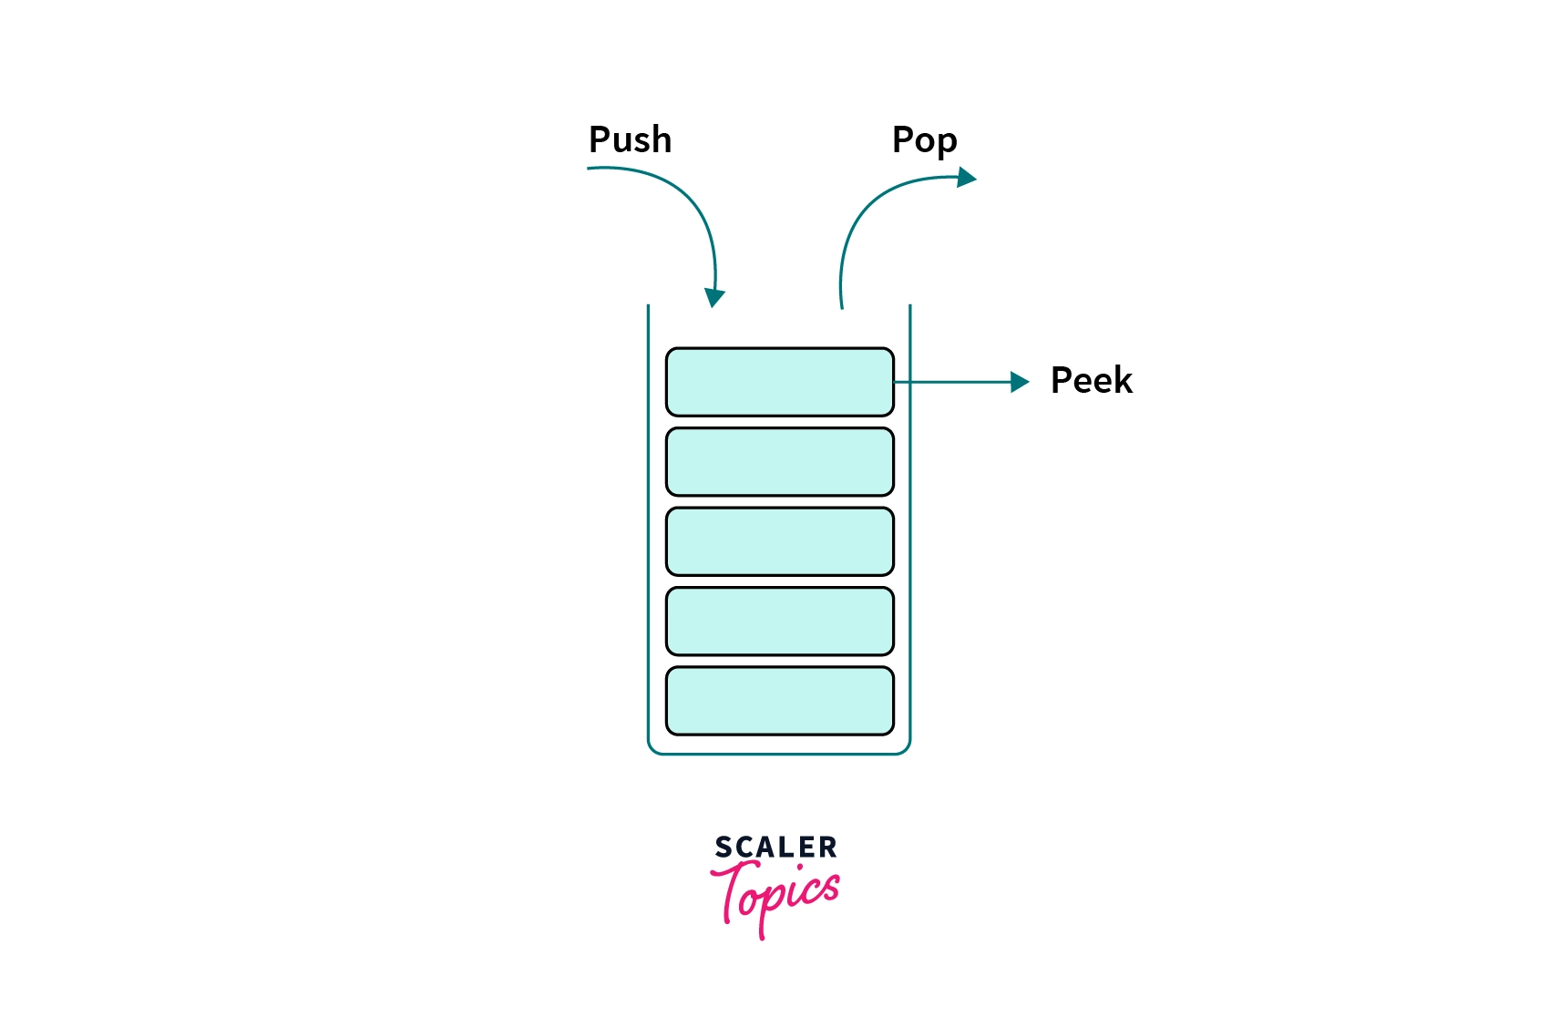
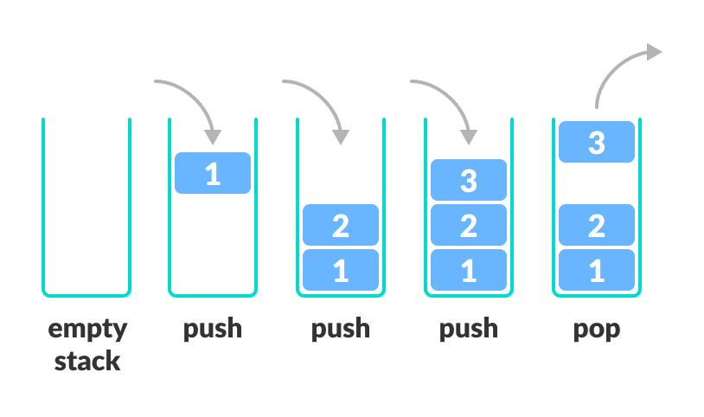
Anatomy of a Test Case - Stack
Peek
Notes:
Let's take a look at an example test case.
In this example, we’re going to use a common programming construct know as a stack

Slide 13
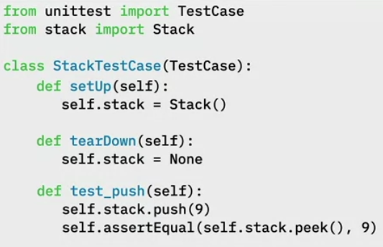
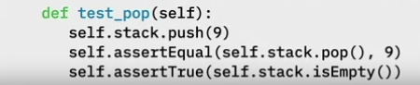
Test Case for push() and pop() function
Test Fixtures: Specify initial state of the of the testcase.
setUp() is declaring an instance variable called self.stack and assigning it to a new Stack.
tearDown() is setting self.stack to None to make sure that it doesn’t get reused
Test Fixtures
Push
Pop
Peek
9
Notes:
Let's take a look at an example test case.
In this example, we’re going to use a common programming construct know as a stack
1. First, we will import the TestCase and the Stack classes
2. Write out class StackTestCase
3. Write the text Fixtures that allows you to specify the initial state of the of the system before a test case is run
setUp() is declaring an instance variable called self.stack and assigning it to a new Stack.
tearDown() is setting self.stack to None to make sure that it doesn’t get reused
4. Now we write our first Test Case test_push(self)
When the program executes, self.stack = Stack() will be called
Next, self.stack.push(9) is called

Slide 14
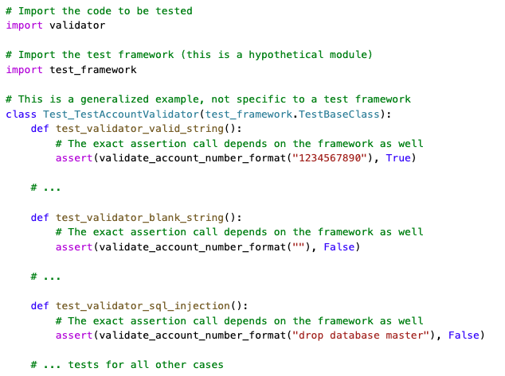
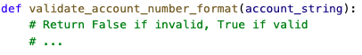
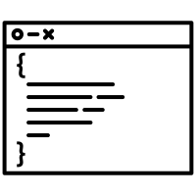


Rules for Good Unit Tests
Production Code
Unit tests should add value to your project.
The same high-quality requirements for the production code should be valid for the unit test code.
Ideally, there should be no distinction between production and test code—they are equal.
Test Code
Notes:
Unit tests should add value to your project. To achieve this goal, you need to follow some essential rules, which I describe in
this section.
The same high-quality requirements for the production code have to be valid for the unit test code. I’ll go even further. Ideally, there should be no distinction between production and test code—they are equal.

Slide 15
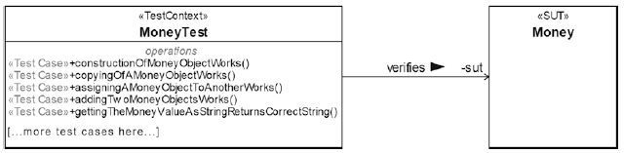
Rules for Good Unit Tests - Unit Test Naming
If a unit test fails, the developer wants to know immediately:
What is the name of the unit; whose test failed?
What was the expected test result, and what was the actual test result of the failed test?
Test Name: <Unit_Under_Test>Test
<Unit_Under_Test>

Slide 16
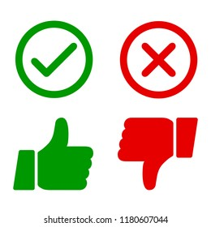
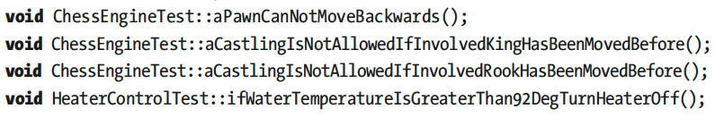
Rules for Good Unit Tests - Unit Test Naming
Expressive and descriptive unit tests
Undescriptive unit tests
<PreconditionAndStateOfUnitUnderTest>_<TestedPartOfAPI>_<ExpectedBehavior>
testConstructor()
test4391()
sumTest()
cacheIsEmpty_addElement_sizeIsOne()
cacheContainsOneElement_removeElement_sizeIsZero();
givenTwoComplexNumbers_add_Works()
givenTwoMoneyObjectsWithDifferentBalance_InequalityComparison_Works()
invoiceIsReadyForAccounting_getInvoiceDate_returnsToday()
Examples of Unit Test Names that Verify Domain-Specific Requirements

Slide 17
Rules for Good Unit Tests – One Assession per Test
void MoneyTest::givenTwoMoneyObjectsWithDifferentBalance_
InequalityComparison_Works() {
const Money m1(-4000.0);
const Money m2(2000.0);
ASSERT_TRUE(m1 != m2);
}
void MoneyTest::givenTwoMoneyObjectsWithDifferentBalance_
testAllComparisonOperators() {
const Money m1(-4000.0);
const Money m2(2000.0);
ASSERT_TRUE(m1 != m2);
ASSERT_FALSE(m1 == m2);
ASSERT_TRUE(m1 < m2);
ASSERT_FALSE(m1 > m2);
// ...more assertions here...
}
void MoneyTest::givenTwoMoneyObjectsWithSameBalance_
EqualityComparison_Works() {
const Money m1(-4000.0);
const Money m2(2000.0);
ASSERT_TRUE(m1 == m2);
}
Difficult to find cause of error
Early failing assertions obsures additional errors
“...testAllComparisonOperators()” not a good name.

Slide 18
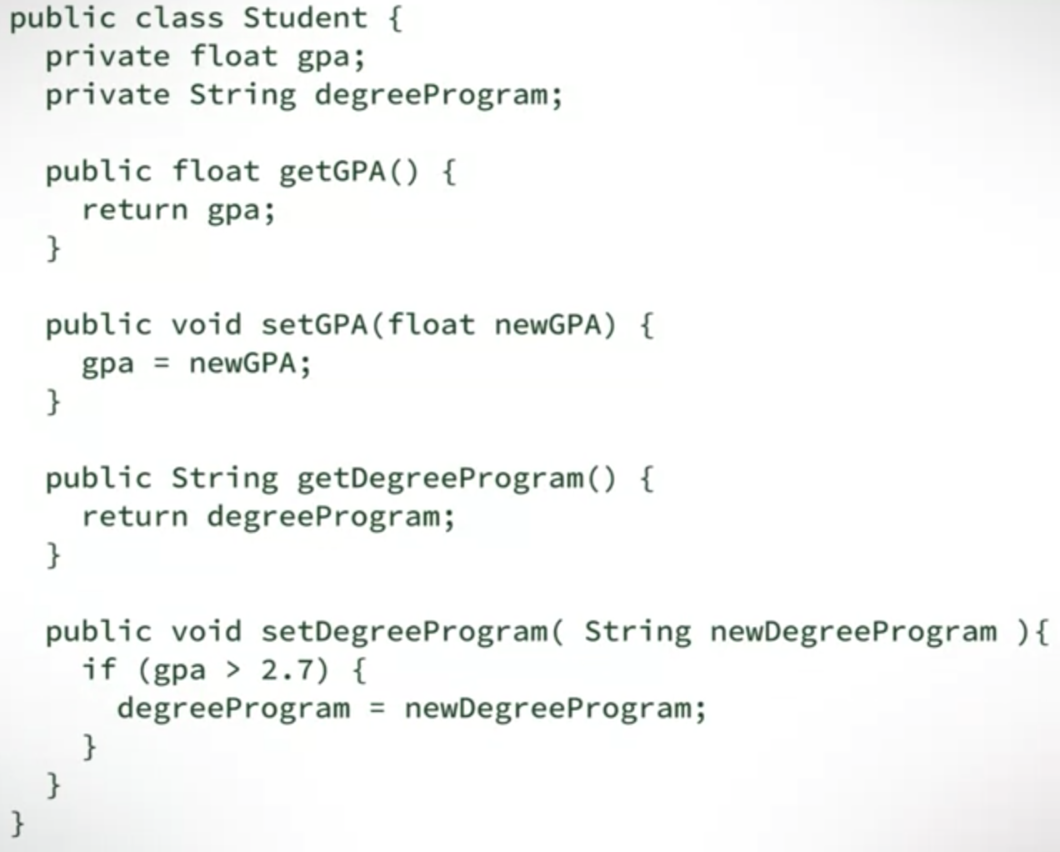
Rules for Good Unit Tests – Exclude Getters and Setters
Don’t write unit tests for usual/simple getters and setters of a class
Sometimes, getters and setters are not that simple, especially those that implement information hiding
Notes:
Do you really expect that something could go wrong with such straightforward methods? These member functions are typically so simple that it would be foolish to write unit tests for them. Furthermore, usual getters and setters are implicitly tested by other and more important unit tests.

Slide 19
Rules for Good Unit Tests – Exclude Third-Party Code
We don’t have to verify that libraries or frameworks do work as expected

Slide 20
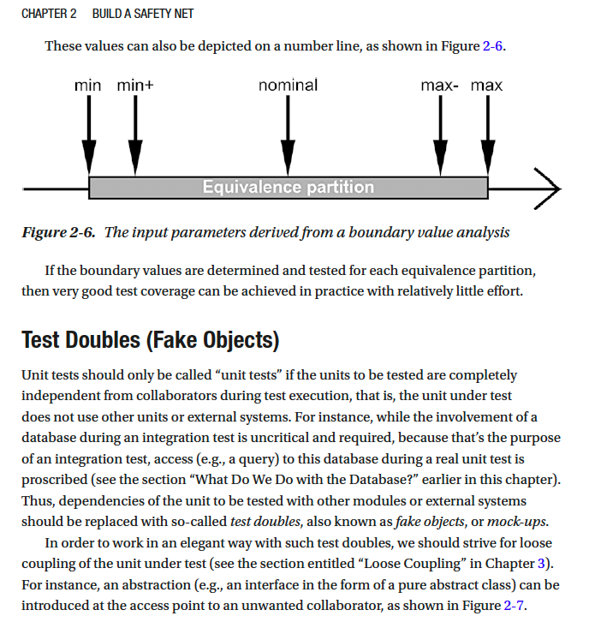
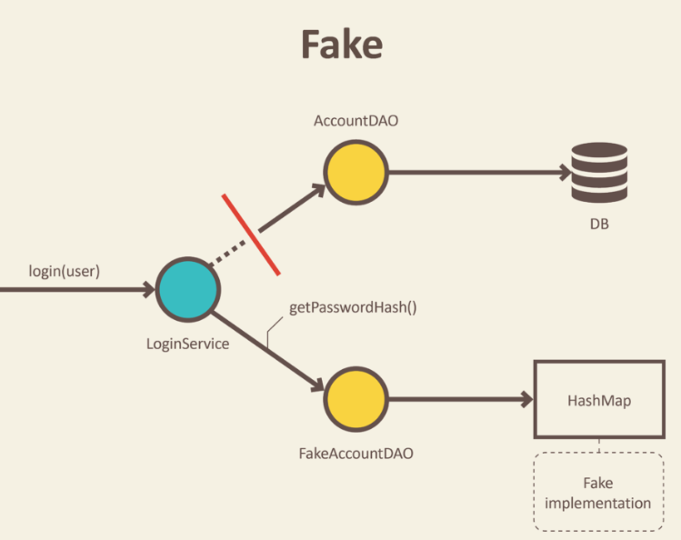
Rules for Good Unit Tests – Exclude External Systems
Mock things out and test your code, not theirs
Read – Test Doubles (Fake Objects)
https://blog.pragmatists.com/test-doubles-fakes-mocks-and-stubs-1a7491dfa3da
Book: Clean C++20: Chapter 2

Slide 21
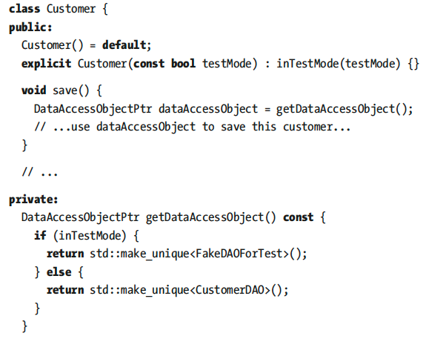
Rules for Good Unit Tests – Don’t Mix Test Code with Production Code
Avoid Dependencies to Test Code

Slide 22



Rules for Good Unit Tests – Tests Must Run Fast
>1000 unit tests
Large Software Project
contains
If running all unit tests takes 15 minutes, ½ hour, or more, developers are impeded in doing their work
If 1-test tales 0.5 secs -> 1,000-tests will take 8 minutes
Executing the whole test suit 10 times will cost 1.5 hours of waiting time.
This might result developers running tests less times.
A good test suit should run under 3-minutes

Slide 23



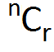
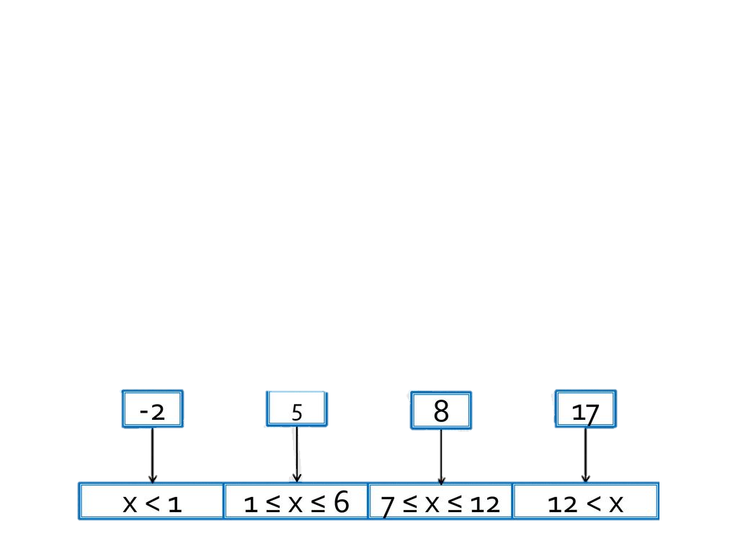


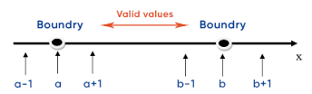

Rules for Good Unit Tests – Tests Input Data
How do I find all test cases that are necessary to ensure good fault detection?
Test cases
High Test Coverage
Select tests
Equivalence Partitioning/Class
Boundary Value Analysis
Test cases
Notes:
A large set of input combinations and you will end up with an almost infinite number of test cases.

Slide 24
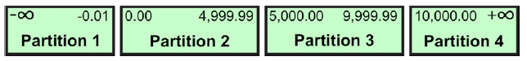
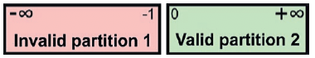
Rules for Good Unit Tests – Tests Input Data
Equivalence Partitioning
Test input data/test cases:
{-2, 5, 8, 17}
Partitions:
1
2
3
4
Bank Interest Calculator API
The bank charges 4 percent penalty interest on overdrafts.
The bank offers 0.5 percent interest for the first 5,000 USD savings.
The bank offers 1 percent interest for the next 5,000 USD savings.
The bank offers 2 percent interest for the rest.
Interest is calculated on a daily basis.
Two Classes
Amount of money as interest is calculated on a daily basis
number of days for which this amount is valid
The equivalence partitioning for the amount of money
The equivalence partitioning for number of days
Notes:
Let us use and example of the The bank interest calculator API with the following requirements
The idea behind equivalence partitioning is that it is enough to pick only one value from each partition for testing. The hypothesis behind this technique is that if one condition/value in a partition passes a test, all others in the same partition will also pass.
Likewise, if one condition/value in a partition fails, all other conditions/values in that partition will also fail. If there is more than one parameter, as in our case, appropriate combinations should be formed.

Slide 25
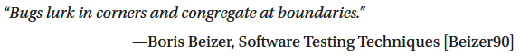

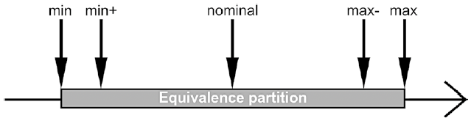

Rules for Good Unit Tests – Tests Input Data
Boundary Value Analysis
Extreme value
High Test Coverage
The input parameters derived from a boundary value analysis
The boundary values are determined and tested for each equivalence partition
Notes:
Now let us look at boundary value analysis
Many software bugs can be traced back to difficulties in the border areas of the equivalence classes, for example at the transition between two valid equivalence classes, between a valid and an invalid equivalence class, or due to an extreme value that was not taken into account.
The result of such an analysis is useful to select the input values of a numerical parameter for the tests: min, min+1, nominal, max-1, max
If the boundary values are determined and tested for each equivalence partition, then very good test coverage can be achieved in practice with relatively little effort.

Slide 26
Quality of a Test Suite
How do you know if your unit test cases are good enough?
Are they really testing the application?
When do we stop testing?
Solution: Test Coverage!

Slide 27
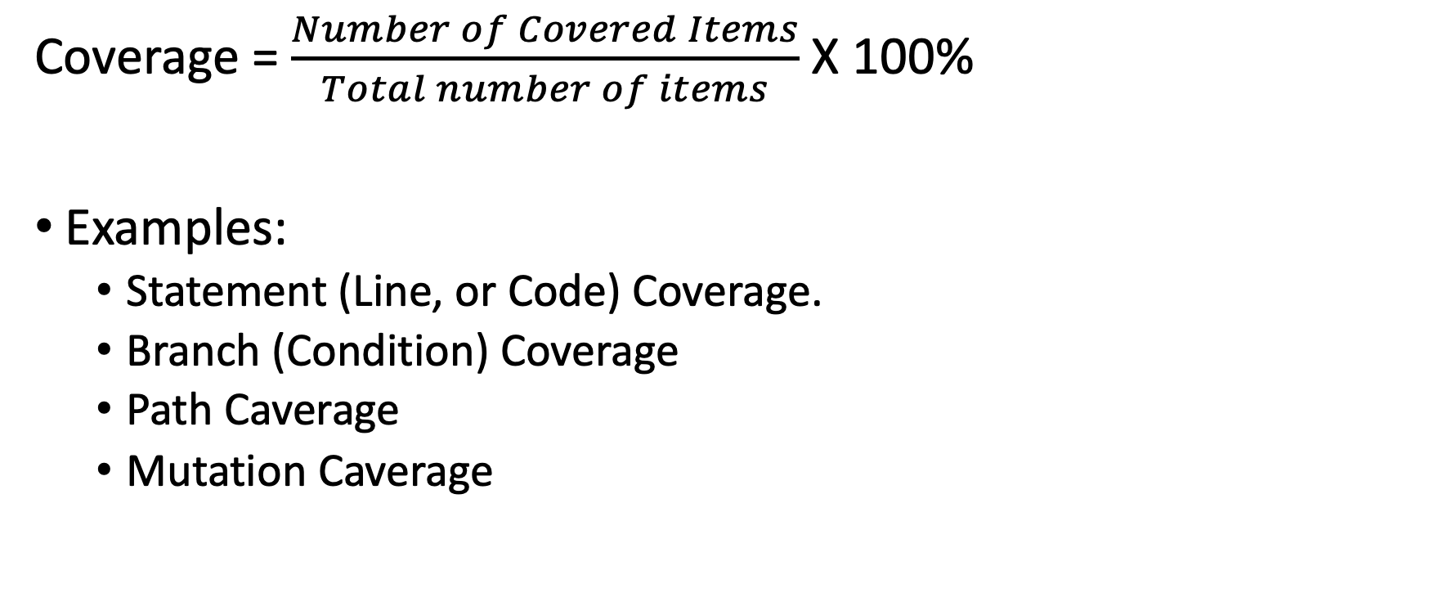
Test Coverage
Coverage = $\frac{Number of Covered Items}{Total number of items}$ X 100%
Examples:
Statement (Line, or Code) Coverage.
Branch (Condition) Coverage
Path Caverage
Mutation Caverage

Slide 28
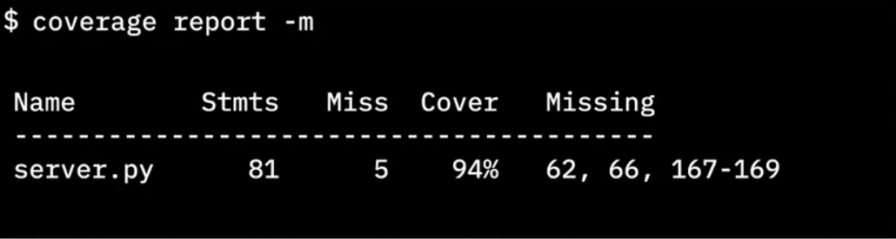
Importance of test coverage
High test coverage gives you confidence that your code works as expected
Test coverage reports can reveal which lines of code were not tested
Python cmd tool
Total lines of code
# lines without test cases
Percent of coverage
Lines without test cases
Notes:
Finally it gives us the line numbers that did not have test cases.
This info is critical because now we know where to concentrate our tests.
We need to go write more test cases to cause those lines of code to be executed.

Slide 29
Full test coverage
You must include “happy” paths and “Sad” paths to get full test coverage
100% test coverage only means that every line of code has been tested with some known good data.
You can still pass bad data into your code and find bugs.
Even with 100% test coverage, your code can still have bugs
Don’t stop testing when your code reaches 100%
Notes:
100% test coverage only means that every line of code has been tested with some known good data.
You can still pass bad data into your code and find bugs.
So don't stop testing when your code cover reaches 100%.
Keep challenging the integrity of your code with bad data and corner cases to make sure
your code behaves as expected under both favourable and adverse conditions.

Slide 30
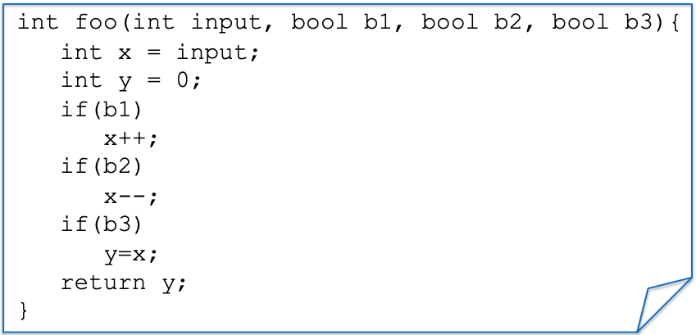
Example: a function to test
Notes:
We have a simple function foo with inputs - > three booleans b1, b2, b3
We also have three if statements that manipulate the input

Slide 31
Statement/Line/Code Coverage
Test Case(s)
ASSERT foo(0, true, true, true) == 0;
Notes:
Suppose we have a test case trying to assert if I call this function foo with ASSERT foo(0, true, true, true)

Slide 32
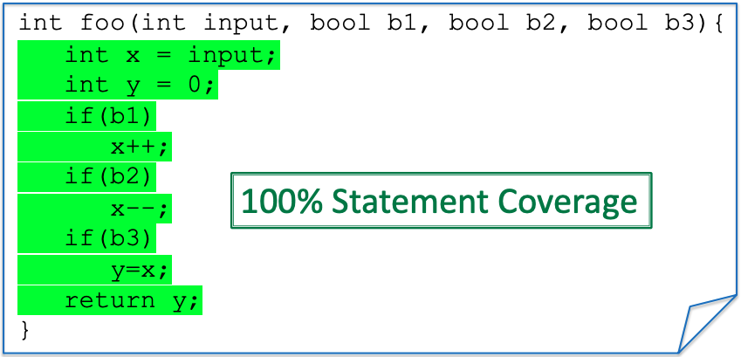
Statement/Line/Code Coverage
Test Case(s)
ASSERT foo(0, true, true, true) == 0;
Notes:
All the lines of this code will be executed, and hence we have 100% coverage
If I change one of the

Slide 33
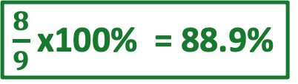
Statement/Line/Code Coverage
Test Case(s)
ASSERT foo(0, true,, true, true) == -1;
false
$\frac{8}{9}$ x100% = 88.9%
x++;
Notes:
All the lines of this code will be executed, and hence we have 100% coverage
If I change one of the

Slide 34
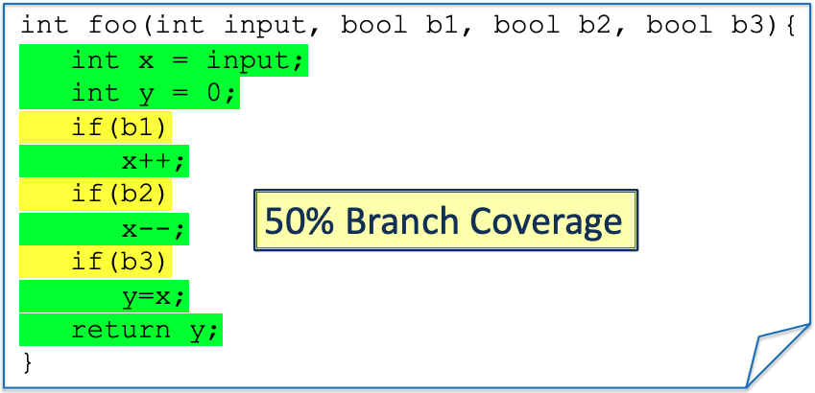
Branch/Condition Coverage
Test Case(s)
ASSERT foo(0, true, true, true) == 0;
Notes:
Branch every condition.
All the different states of the condition (true or false) need to be tested.
The TC needs to go inside the if and inside the else.
In this case, we only have the only if and no else.

Slide 35
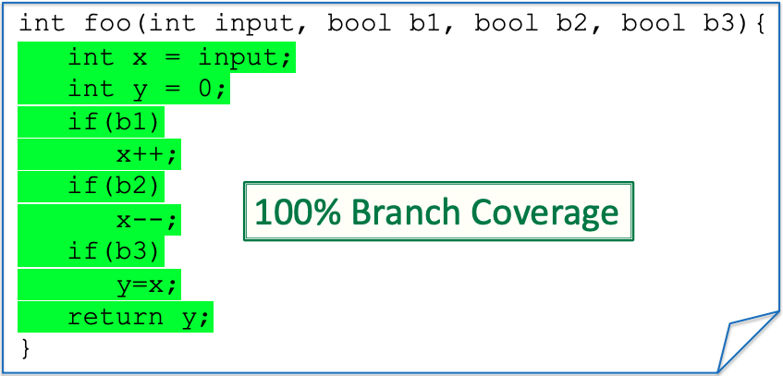
Branch/Condition Coverage
New Test
Test Case(s)
ASSERT foo(0, true, true, true) == 0;
Assert foo(0,false, false, false) == 0;

Slide 36
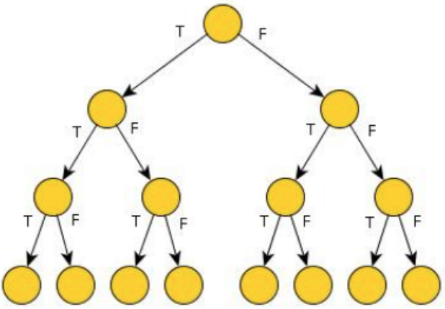
Path Coverage
Paths for three “if” each can be either true (T) or false (F)
8-Paths

Slide 37

Path Coverage
Test Case(s)
ASSERT foo(0, true, true, true) == 0;
ASSERT foo(0,false, false, false) == 0;
25% Path Coverage
Notes:
As you can see, conditionals (and loops) make path coverage hard. We need to write a lot of tests
We get an exponential number of paths on the number of conditionals tests.
This is going to be very costly to test, but on the other hand, it could be that a bug is hidden in one of the paths
We need path coverage to find certain bugs

Slide 38
Test drive the development
TDD is a software development approach where tests are written before the actual code. The cycle can be summarized as Red-Green-Refactor.
Red: Write a failing test (indicating that the functionality doesn't exist or work yet).
Green: Write the minimal amount of code to make the test pass.
Refactor: Clean up the code while ensuring the test still passes.

Slide 39
Basic TDD workflow
RED
(Fail)
Write test case that fails
Red,
Green,
Refactor
REFACTOR
GREEN
(Pass)
Write code for test case – tests pass
Improve the code quality
I have prepared the lab which will guide you in practicing with TDD
Notes:
The TDD Cycle
Step 1: Write a test that defines a function or improvements of a function.
Step 2: Run the test and see it fail (this ensures the test is working and the feature isn't implemented yet).
Step 3: Write the simplest possible code to pass the test.
Step 4: Refactor the code while keeping the tests green.
Step 5: Repeat for each new feature or function.

Slide 40











Unit Tests Frameworks
Testing framework
Notes:
There are several different unit test frameworks available for C++ development, for example, CppUnit, Boost.Test, CUTE, Google Test, Catch respectively Catch2, and a couple more.

Slide 41
Testing Coverage for the Project
It is required to show coverage for your Project (DP II and DP III)
At least Statement Coverage, but Branch Coverage is better.
If your project has very low coverage, you better have a good explanation for that.
Focus on increasing the coverage for the system parts that will be affected by your change.

Slide 42
